Slide 1
STM32 using Bluetooth in STM32CubeIDE
Open your STM32CubeIDE then go to File > New > STM32 project.
Then click on Board Selector tab and search your selected development board or Microcontroller in the search bar. In our case, we select NUCLEO-F072RB development board then click Next and click finish.
Write the name of the project in Project Name field also Select your project location (workspace) and click Finish button. In our case, we select the default location.

Slide 2
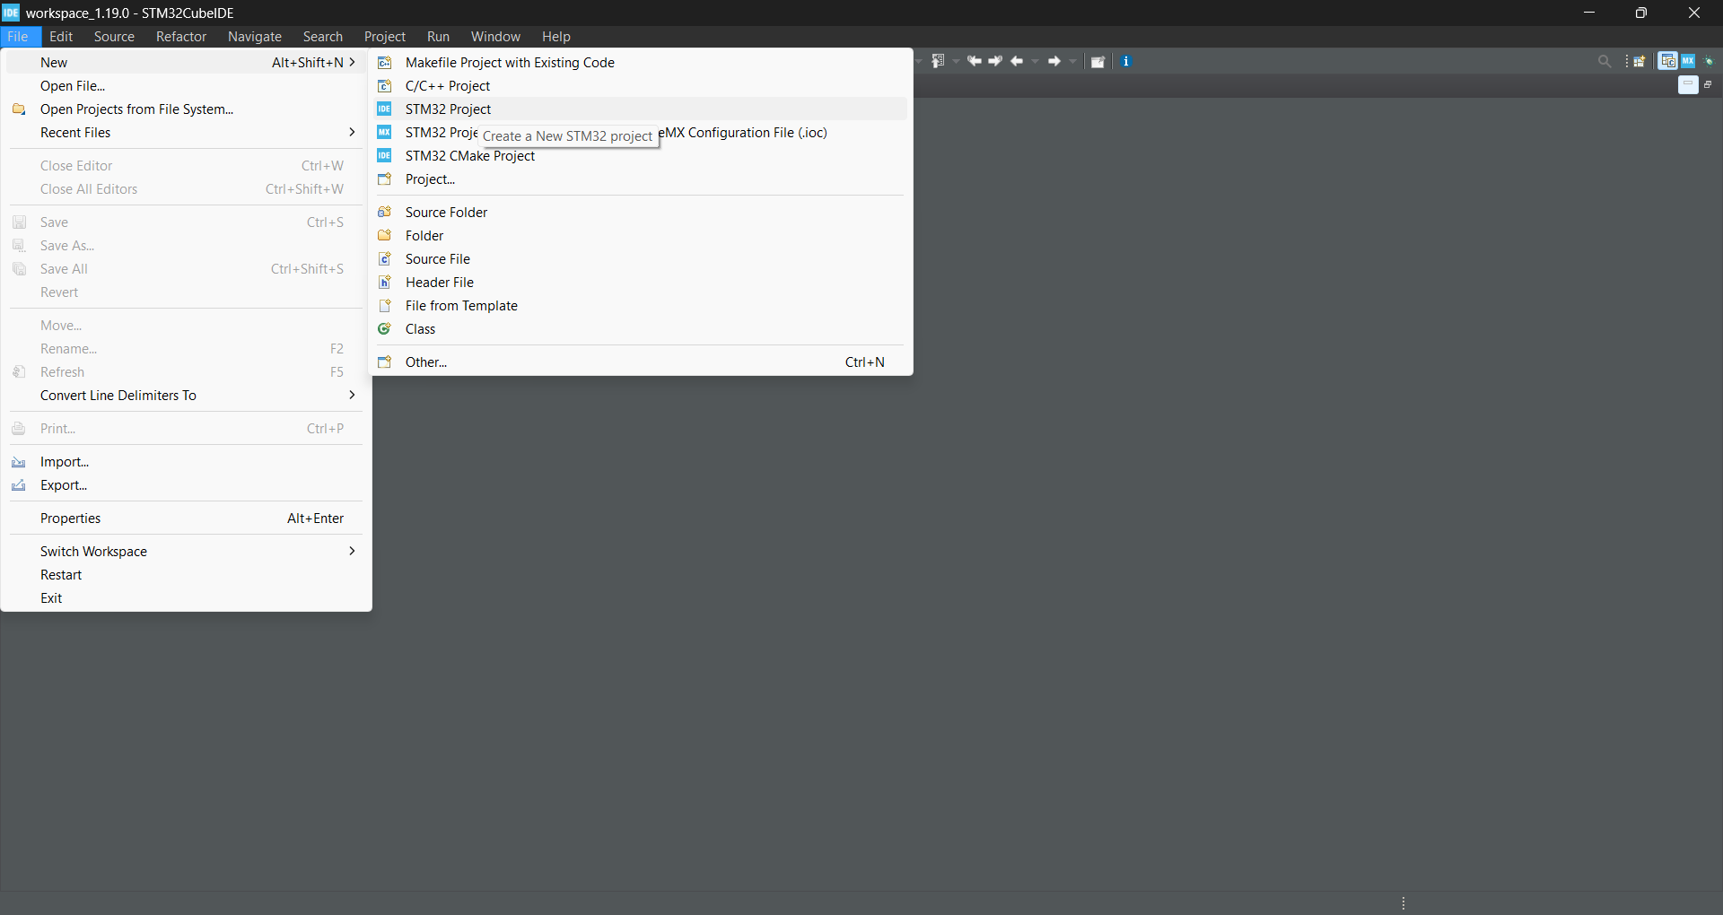

Slide 3
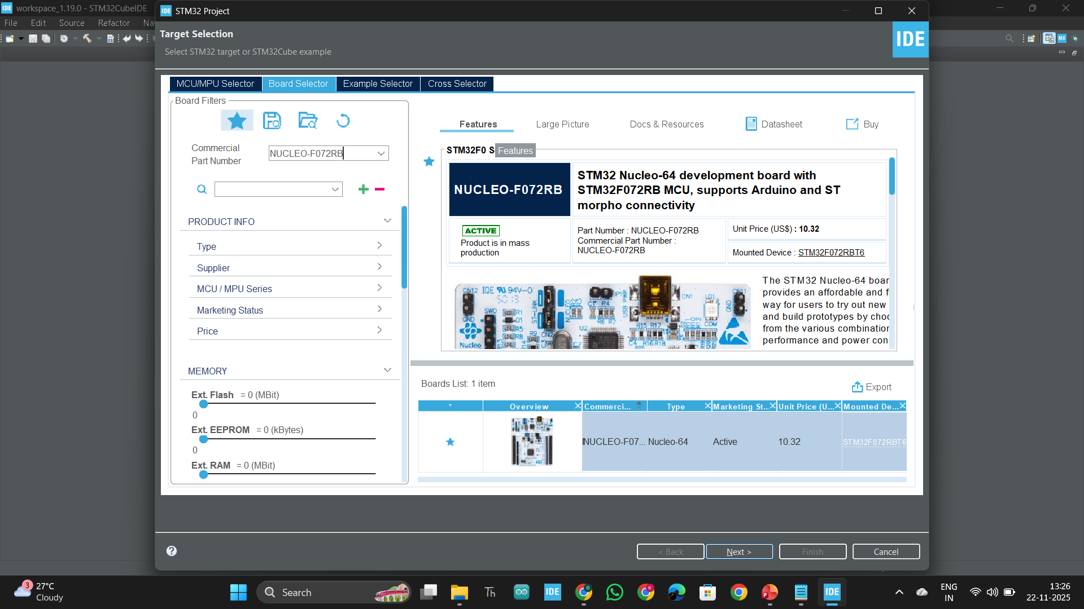

Slide 4
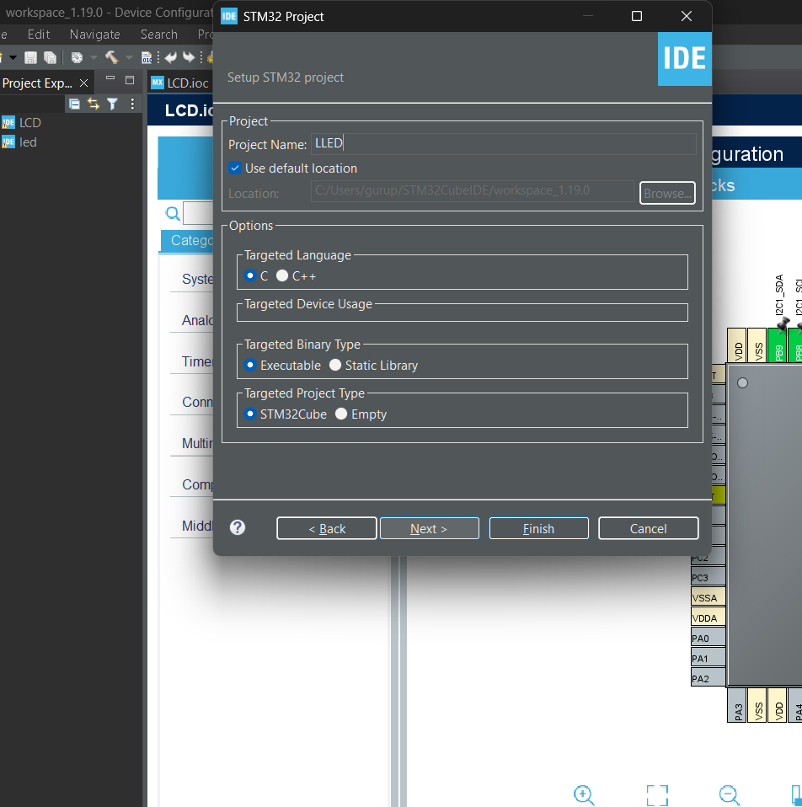

LCD using STM32CubeIDE
3/19

Slide 5
STM …Contd...
If you want to view or edit your configuration settings double click to your project.ioc file and open the Device Configuration Tool of STM32CubeIDE. Change the configuration settings as your project needs.
By default STM32Cube Ide add some default configuration settings in this tool like RCC Clock settings and UART peripheral configurations, if you select any STM32 development board for your project.
Check baud rate and make sure NVIC interrupt table USART1 global interrupt will be enable.
3/19

Slide 6
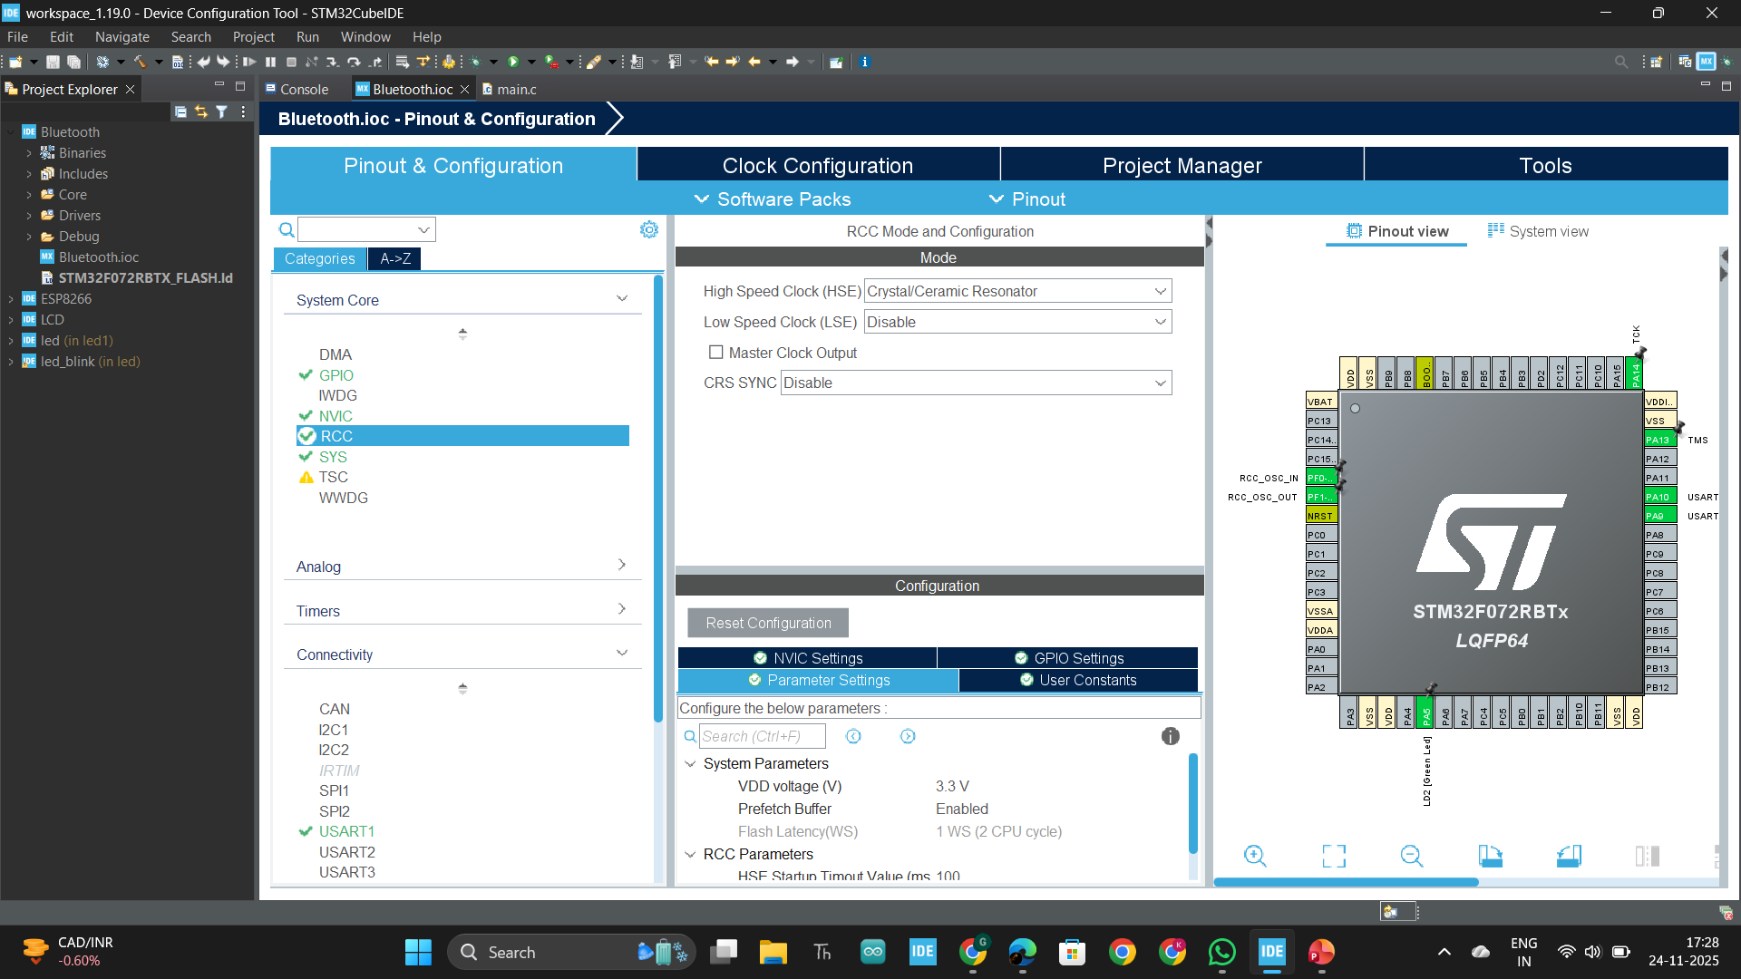

STM …Contd...
3/19

Slide 7
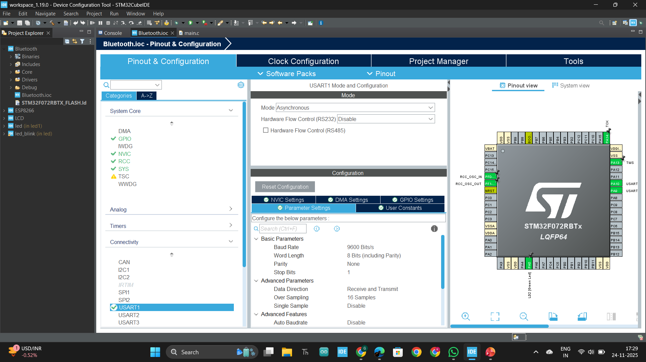


STM …Contd...
3/19

Slide 8
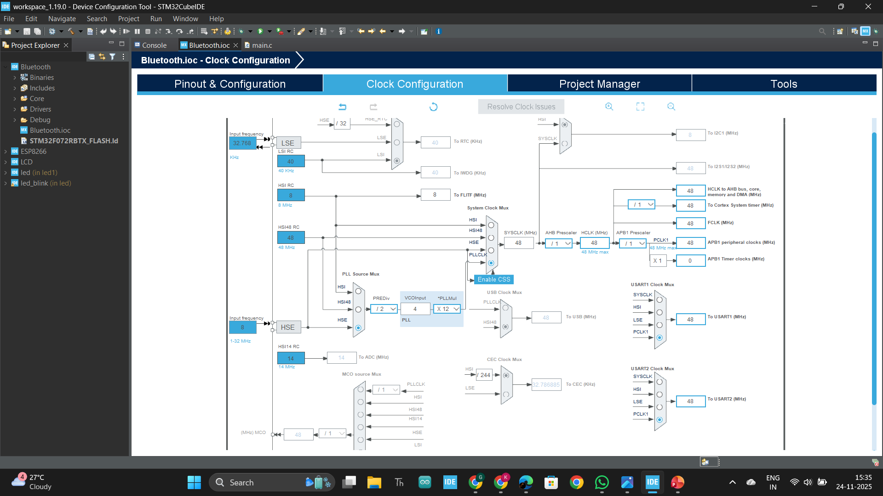



STM …Contd...
3/19

Slide 9
STM …Contd...
After finish all the configurations, click on File > Save and Generate the code.
After complete the code writing first build the project by clicking the build tool.
Then click to Run > Run As > STM32 c/c++ Application.
3/19

Slide 10
STM …Contd...
Code :
/* USER CODE BEGIN Header */
/**
******************************************************************************
* @file : main.c
* @brief : Main program body
******************************************************************************
* @attention
*
* Copyright (c) 2024 STMicroelectronics.
* All rights reserved.
*
* This software is licensed under terms that can be found in the LICENSE file
* in the root directory of this software component.
* If no LICENSE file comes with this software, it is provided AS-IS.
*
******************************************************************************
*/
/* USER CODE END Header */
/* Includes ------------------------------------------------------------------*/
#include "main.h"
/* Private includes ----------------------------------------------------------*/
/* USER CODE BEGIN Includes */
/* USER CODE END Includes */
/* Private typedef -----------------------------------------------------------*/
/* USER CODE BEGIN PTD */
/* USER CODE END PTD */
/* Private define ------------------------------------------------------------*/
/* USER CODE BEGIN PD */
/* USER CODE END PD */
/* Private macro -------------------------------------------------------------*/
/* USER CODE BEGIN PM */
/* USER CODE END PM */
/* Private variables ---------------------------------------------------------*/
UART_HandleTypeDef huart1;
/* USER CODE BEGIN PV */
uint8_t rxData;
/* USER CODE END PV */
/* Private function prototypes -----------------------------------------------*/
void SystemClock_Config(void);
static void MX_GPIO_Init(void);
static void MX_USART1_UART_Init(void);
/* USER CODE BEGIN PFP */
/* USER CODE END PFP */
/* Private user code ---------------------------------------------------------*/
/* USER CODE BEGIN 0 */
/* USER CODE END 0 */
/**
* @brief The application entry point.
* @retval int
*/
int main(void)
{
/* USER CODE BEGIN 1 */
/* USER CODE END 1 */
/* MCU Configuration--------------------------------------------------------*/
/* Reset of all peripherals, Initializes the Flash interface and the Systick. */
HAL_Init();
/* USER CODE BEGIN Init */
/* USER CODE END Init */
/* Configure the system clock */
SystemClock_Config();
/* USER CODE BEGIN SysInit */
/* USER CODE END SysInit */
/* Initialize all configured peripherals */
MX_GPIO_Init();
MX_USART1_UART_Init();
/* USER CODE BEGIN 2 */
HAL_UART_Receive_IT(&huart1,&rxData,1);
/* USER CODE END 2 */
/* Infinite loop */
/* USER CODE BEGIN WHILE */
while (1)
{
/* USER CODE END WHILE */
/* USER CODE BEGIN 3 */
}
/* USER CODE END 3 */
}
/**
* @brief System Clock Configuration for STM32F0 (uses HSI48)
* This implementation is compatible with STM32F072 series.
*/
void SystemClock_Config(void)
{
RCC_OscInitTypeDef RCC_OscInitStruct = {0};
RCC_ClkInitTypeDef RCC_ClkInitStruct = {0};
RCC_PeriphCLKInitTypeDef PeriphClkInit = {0};
/* Enable HSI48 oscillator */
RCC_OscInitStruct.OscillatorType = RCC_OSCILLATORTYPE_HSI48;
RCC_OscInitStruct.HSI48State = RCC_HSI48_ON;
RCC_OscInitStruct.PLL.PLLState = RCC_PLL_NONE; /* no PLL here */
if (HAL_RCC_OscConfig(&RCC_OscInitStruct) != HAL_OK)
{
Error_Handler();
}
/* Select HSI48 as system clock source and configure the HCLK and PCLK1 clock dividers */
RCC_ClkInitStruct.ClockType RCC_CLOCKTYPE_SYSCLK | RCC_CLOCKTYPE_HCLK | RCC_CLOCKTYPE_PCLK1;
RCC_ClkInitStruct.SYSCLKSource = RCC_SYSCLKSOURCE_HSI48;
RCC_ClkInitStruct.AHBCLKDivider = RCC_SYSCLK_DIV1; /* HCLK = SYSCLK */
RCC_ClkInitStruct.APB1CLKDivider = RCC_HCLK_DIV1; /* PCLK1 = HCLK */
if (HAL_RCC_ClockConfig(&RCC_ClkInitStruct, FLASH_LATENCY_1) != HAL_OK)
{
Error_Handler();
}
/* Configure peripheral clocks (USART1/USART2 on PCLK1) */
PeriphClkInit.PeriphClockSelection = RCC_PERIPHCLK_USART1 | RCC_PERIPHCLK_USART2;
PeriphClkInit.Usart1ClockSelection = RCC_USART1CLKSOURCE_PCLK1;
PeriphClkInit.Usart2ClockSelection = RCC_USART2CLKSOURCE_PCLK1;
if (HAL_RCCEx_PeriphCLKConfig(&PeriphClkInit) != HAL_OK)
{
Error_Handler();
}
}
/**
* @brief USART1 Initialization Function
* @param None
* @retval None
*/
static void MX_USART1_UART_Init(void)
{
/* USER CODE BEGIN USART1_Init 0 */
/* USER CODE END USART1_Init 0 */
/* USER CODE BEGIN USART1_Init 1 */
/* USER CODE END USART1_Init 1 */
huart1.Instance = USART1;
huart1.Init.BaudRate = 9600;
huart1.Init.WordLength = UART_WORDLENGTH_8B;
huart1.Init.StopBits = UART_STOPBITS_1;
huart1.Init.Parity = UART_PARITY_NONE;
huart1.Init.Mode = UART_MODE_TX_RX;
huart1.Init.HwFlowCtl = UART_HWCONTROL_NONE;
huart1.Init.OverSampling = UART_OVERSAMPLING_16;
if (HAL_UART_Init(&huart1) != HAL_OK)
{
Error_Handler();
}
/* USER CODE BEGIN USART1_Init 2 */
/* USER CODE END USART1_Init 2 */
}
/**
* @brief GPIO Initialization Function
* @param None
* @retval None
*/
static void MX_GPIO_Init(void)
{
GPIO_InitTypeDef GPIO_InitStruct = {0};
/* USER CODE BEGIN MX_GPIO_Init_1 */
/* USER CODE END MX_GPIO_Init_1 */
/* GPIO Ports Clock Enable */
__HAL_RCC_GPIOD_CLK_ENABLE();
__HAL_RCC_GPIOA_CLK_ENABLE();
__HAL_RCC_GPIOB_CLK_ENABLE();
/*Configure GPIO pin Output Level */
HAL_GPIO_WritePin(LD2_GPIO_Port, LD2_Pin, GPIO_PIN_RESET);
/*Configure GPIO pin : LD2_Pin */
GPIO_InitStruct.Pin = LD2_Pin;
GPIO_InitStruct.Mode = GPIO_MODE_OUTPUT_PP;
GPIO_InitStruct.Pull = GPIO_NOPULL;
GPIO_InitStruct.Speed = GPIO_SPEED_FREQ_LOW;
HAL_GPIO_Init(LD2_GPIO_Port, &GPIO_InitStruct);
/* USER CODE BEGIN MX_GPIO_Init_2 */
/* USER CODE END MX_GPIO_Init_2 */
}
/* USER CODE BEGIN 4 */
void HAL_UART_RxCpltCallback(UART_HandleTypeDef *huart)
{
if(huart->Instance==USART1)
{
if(rxData==79) // Ascii value of 'O' is 79
{
HAL_GPIO_WritePin(GPIOA, GPIO_PIN_5, 1);
}
else if (rxData==88) // Ascii value of 'X' is 88
{
HAL_GPIO_WritePin(GPIOA, GPIO_PIN_5, 0);
}
HAL_UART_Receive_IT(&huart1,&rxData,1); // Enabling interrupt receive again
}
}
/* USER CODE END 4 */
/**
* @brief This function is executed in case of error occurrence.
* @retval None
*/
void Error_Handler(void)
{
/* USER CODE BEGIN Error_Handler_Debug */
/* User can add his own implementation to report the HAL error return state */
__disable_irq();
while (1)
{
}
/* USER CODE END Error_Handler_Debug */
}
#ifdef USE_FULL_ASSERT
/**
* @brief Reports the name of the source file and the source line number
* where the assert_param error has occurred.
* @param file: pointer to the source file name
* @param line: assert_param error line source number
* @retval None
*/
void assert_failed(uint8_t *file, uint32_t line)
{
/* USER CODE BEGIN 6 */
/* User can add his own implementation to report the file name and line number,
ex: printf("Wrong parameters value: file %s on line %d\r\n", file, line) */
/* USER CODE END 6 */
}
#endif /* USE_FULL_ASSERT */
3/19

Slide 11
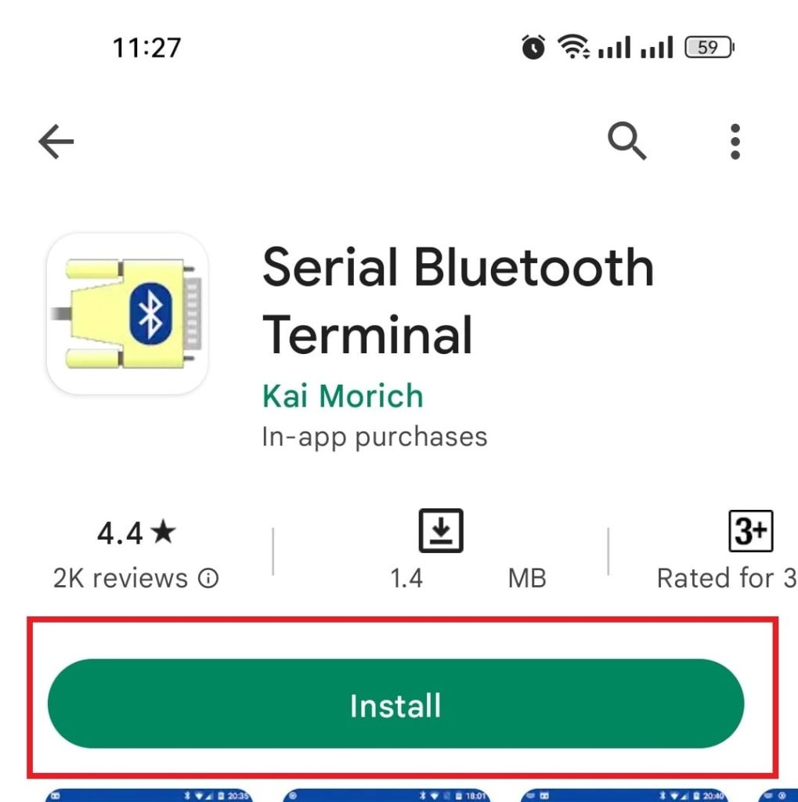
STM …Contd...
Preparing Bluetooth terminal application
Go to the google play store and search “Bluetooth Terminal” select the application shown below and install. After install the application open it.
3/19

Slide 12
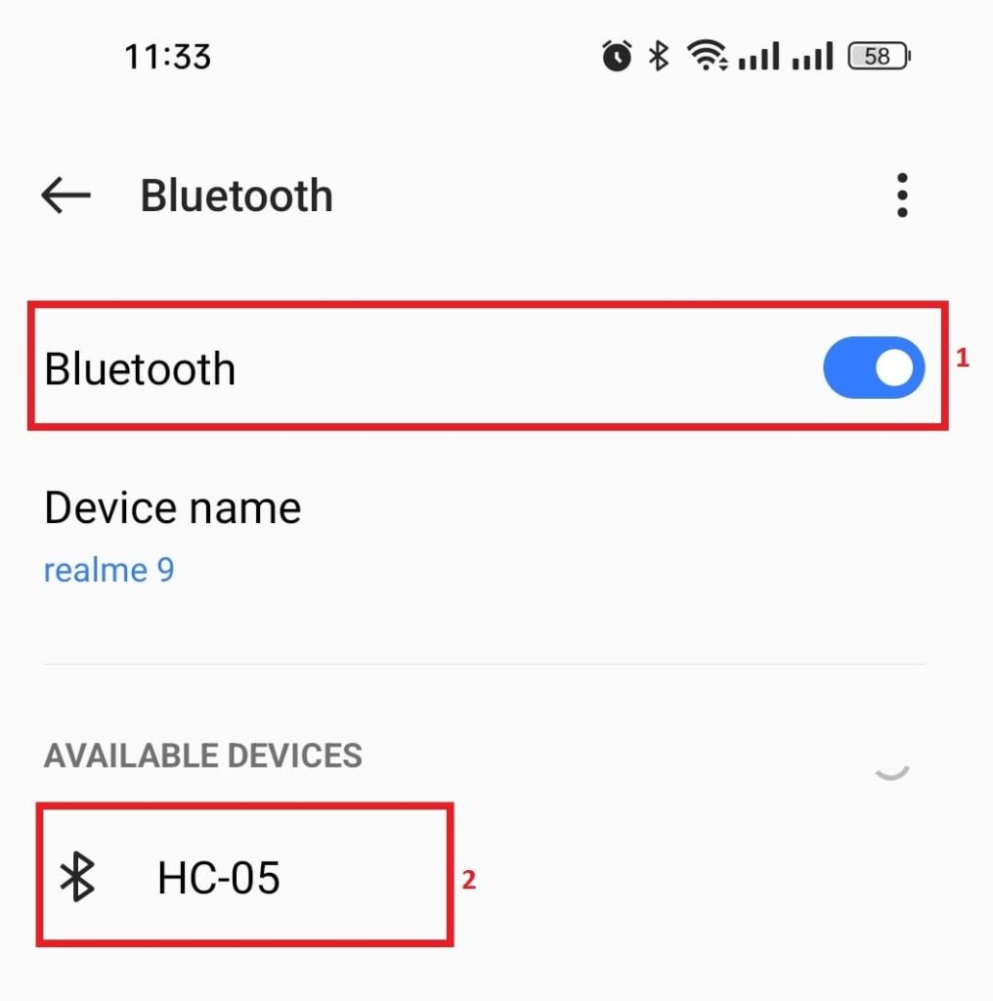
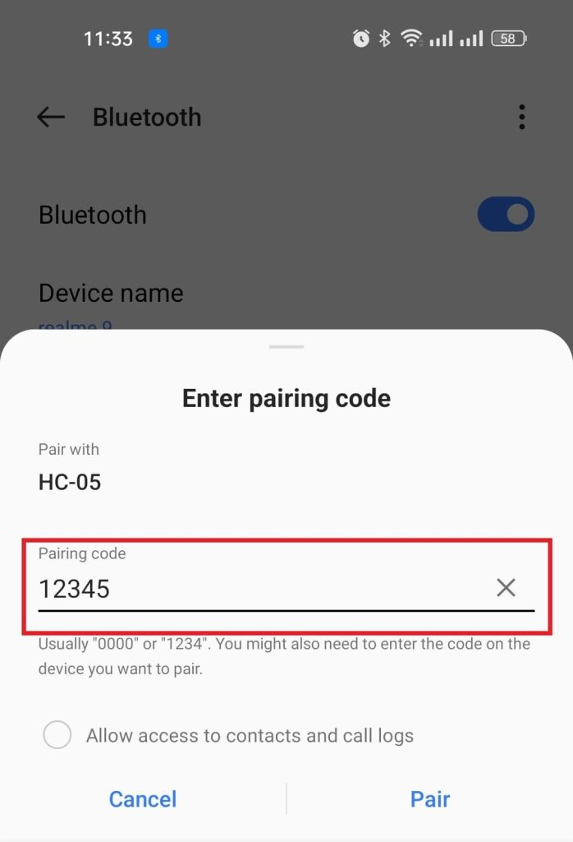
STM …Contd...
Turn on Bluetooth on your mobile phone. Then open the available devices list—your device should appear there. Select it and connect using the default PIN, either ‘0000’ or ‘1234’.
After that open Serial Bluetooth Terminal app.
3/19

Slide 13
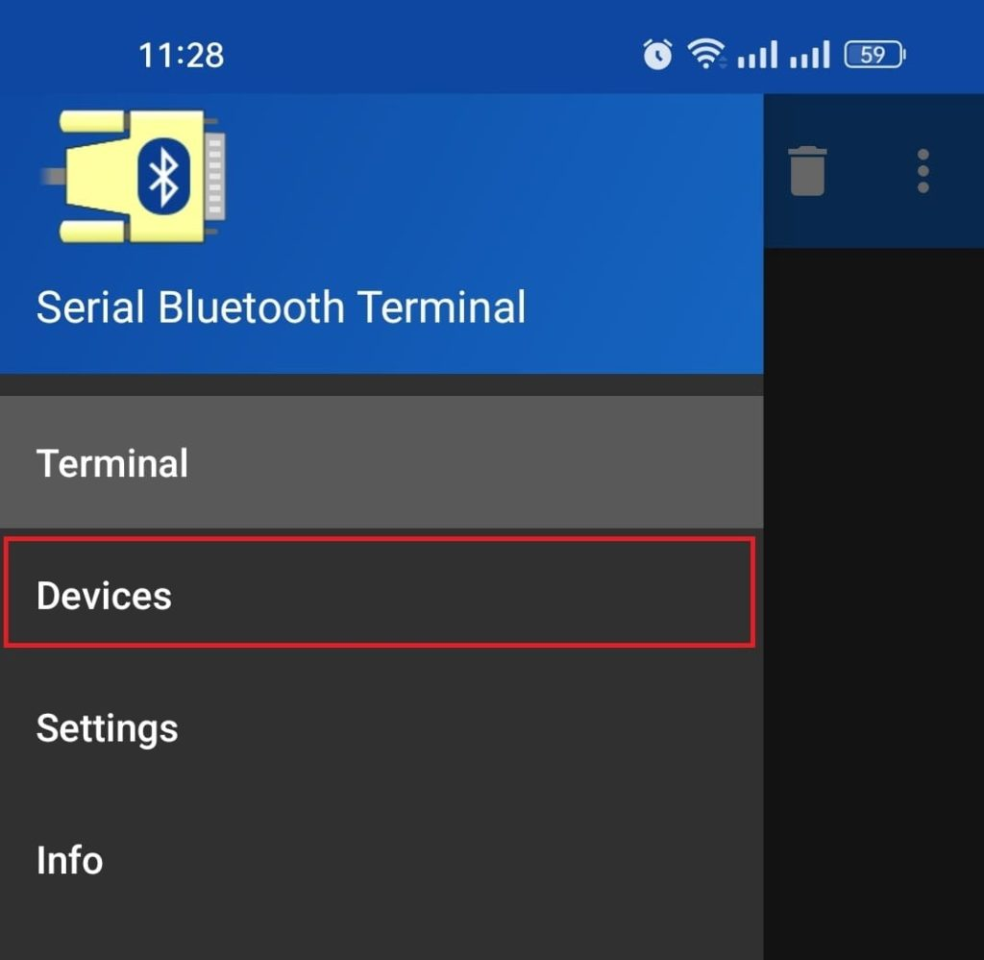
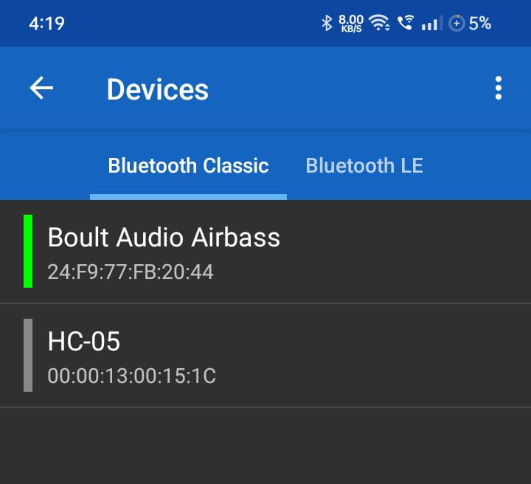
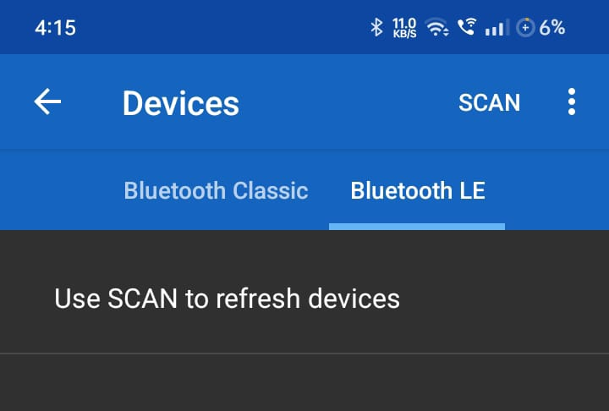
STM …Contd...
Go to the Devices. If your Bluetooth module is HC-05, it will appear under “Bluetooth Classic”.If it is HM-10, it will appear under “BLE.”Select your device to connect.If you don’t see your device, tap “Scan” to refresh the list.
3/19

Slide 14
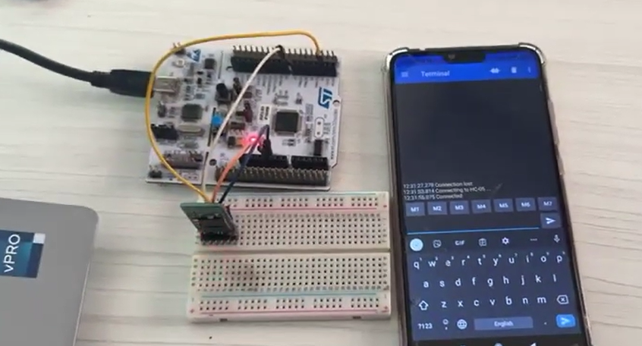
STM …Contd...
If your device is available then connect it. After successfully connected use commands to run project.
REFERENCE : https://microcontrollerslab.com/hc-05-bluetooth-module-stm32-nucleo-stm32cubeide/
3/19

